Slide 1

A DATA SCIENCE APPROACH TO IMPROVING M&A DECISION MAKING
By : Mohamed Amine Chafik
Mohamed El Mehdi Chbihi
Ismail Ghmimat

Slide 2
Table of Contents
01
02
03
Goals
Introduction
Data Constitution
04
05
06
M&A operation success rate via the PSM and diff in diff Method
Predicting deal values
M&A operation success rate via the Isolation Forrest Method

Slide 3

Goals
01

Slide 4

Our Goals.
Through this project, we want to bring up a revolutionary approach to M&A operations. This approach can lead to two key elements of M&A decision making : success rate estimation and pricing.

Slide 5
Introduction
02

Slide 6

What is M&A ?
Mergers and acquisitions (M&A) is a general term used to describe the consolidation of companies or assets through various types of financial transactions, including mergers, acquisitions, consolidations, tender offers, purchase of assets, and management acquisitions.
The terms "mergers" and "acquisitions" are often used interchangeably, although in actuality, they hold slightly different meanings.
When one company takes over another entity, and establishes itself as the new owner, the purchase is called an acquisition.
On the other hand, a merger describes two firms of approximately the same size, who join forces to move forward as a single new entity, rather than remain separately owned and operated.

Slide 7
Some Key Numbers About M&A
800k Transactions
2.8 Trillion $
80% failure
Since 2000, M&A Operations have known an exponantial growth, reaching almost 800k transactions in total !
The global value of M&A Transactions around the world haven gone from 347 billion $, to more than 2.8 trillion $ in 2019
70% to 90% of M&A transactions are labelled as ”failures by executives. Either failing to achieve desired synergies or leading both parties to a financial crisis

Slide 8

Dataset Consitution
03

Slide 9



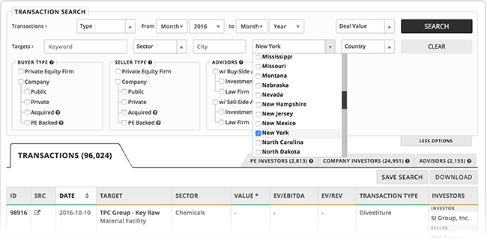
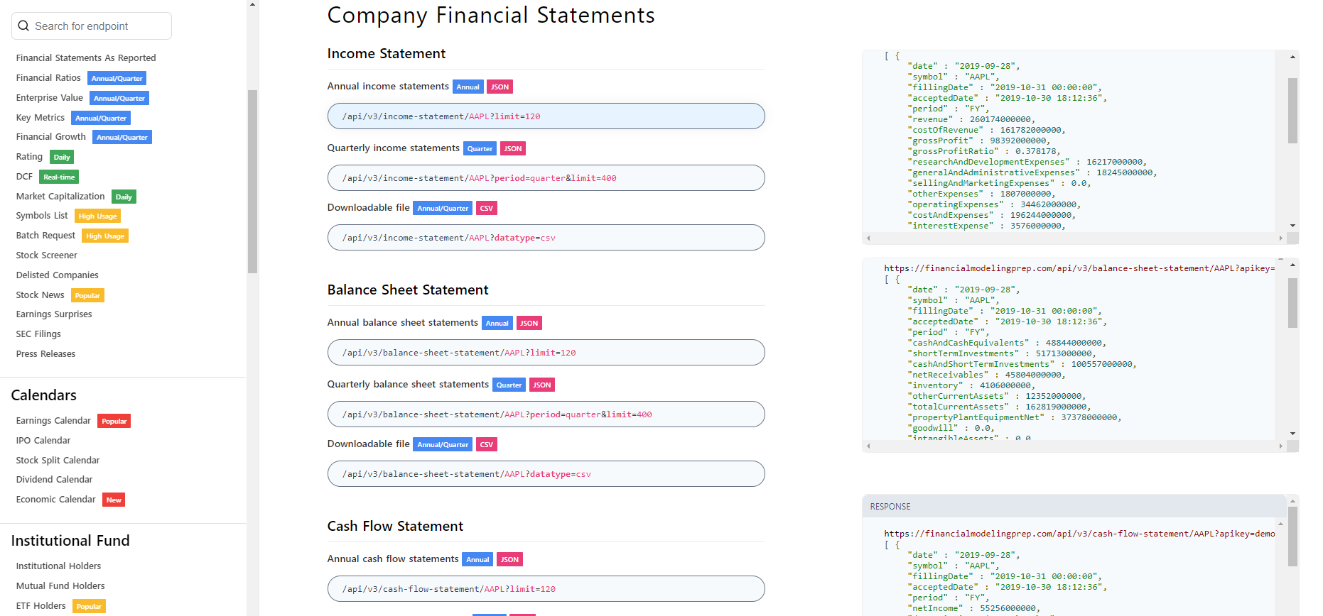
Investors Financial Numbers :
History of Transactions :

Slide 10
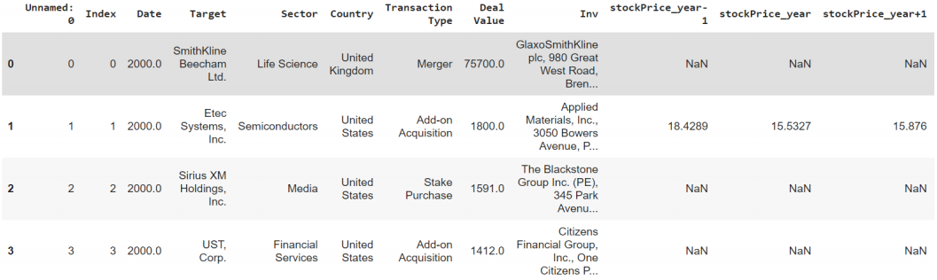
Studied Columns :
Snippet of our 3000-observations dataset :
Inv firm, Target firm, Deal Value, Transaction Type…
5 financial ratios representing 5 performance aspects (+/- 5 years) :
Liquidity Ratios (Current Ratio)
Solvency Ratios (Debt Equity Ratio)
Profitability Ratios (Net Profit Margin)
Market-related Ratios (Stock Price)
Valuation ratios (Earnings Per Share)

Slide 11
Anomaly Detection Using The Isolation Forest Algorithm
04

Slide 12
Problem
Solution
70% to 90% of M&A transactions are labelled as failure.
M&A Deals are key to a company’s financial well being.
Time consuming process
Looking for similarities with “successful” deals instead of evaluating whether the deal should take place.
No one knows exactly how successful an operation is.
Instead of looking for similarities with too scarce transactions, let’s look at how different they are compared to the rest
Unsupervised decision making
A double approach, as ”absolutely successful” mergers and acquisitions are almost impossible.

Slide 13
Generating the model
Fitting the model and predicting anomalies
2121 “Standard” Transactions
530 ”Anomaly” Transactions
Predicting the anomaly score

Slide 14
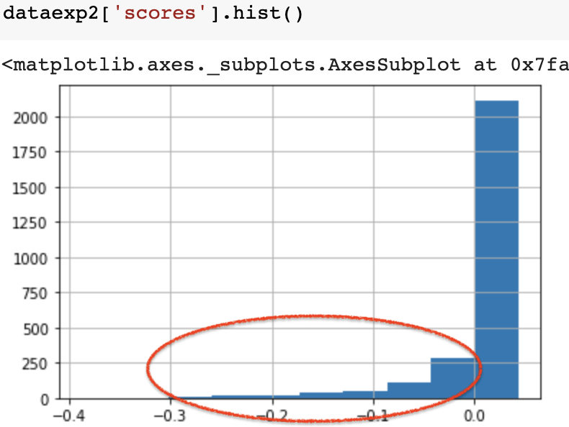
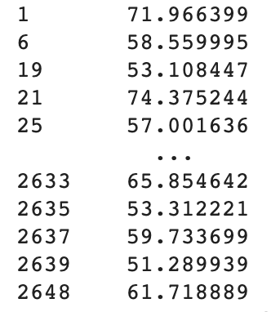
Scores Distribution
Success Rate Formula
We then have this output :
We will be focusing on the red circled part, as it is the one containing anomalies

Slide 15
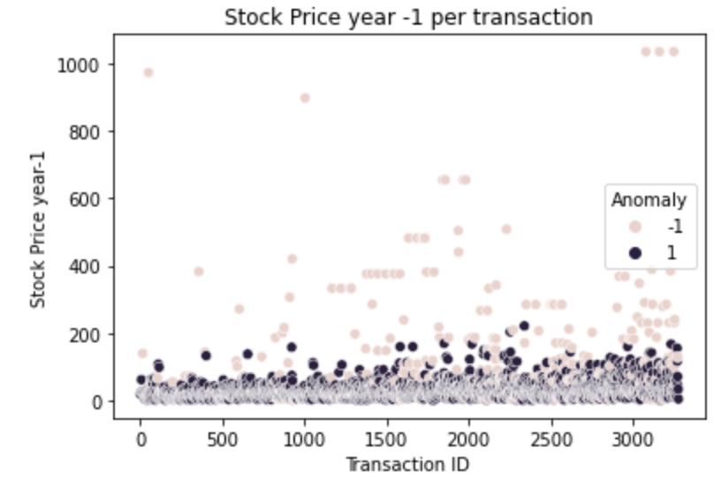
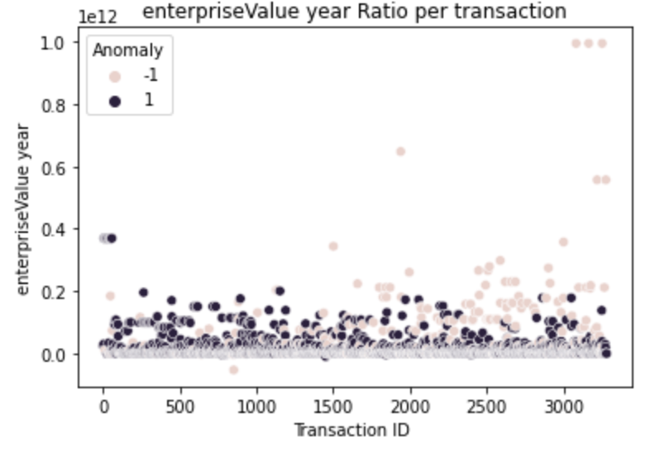
Anomaly Transactions Distribution

Slide 16
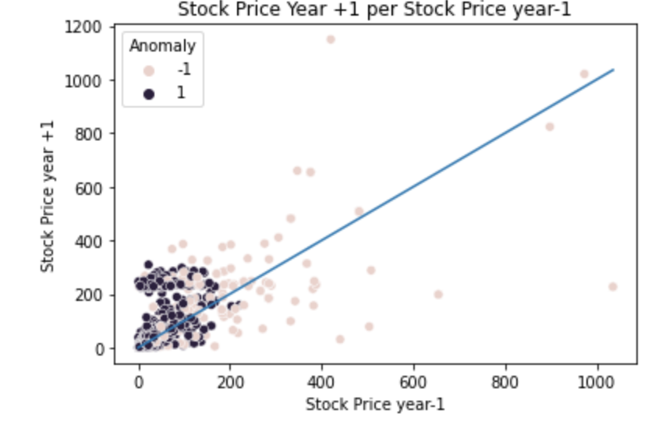
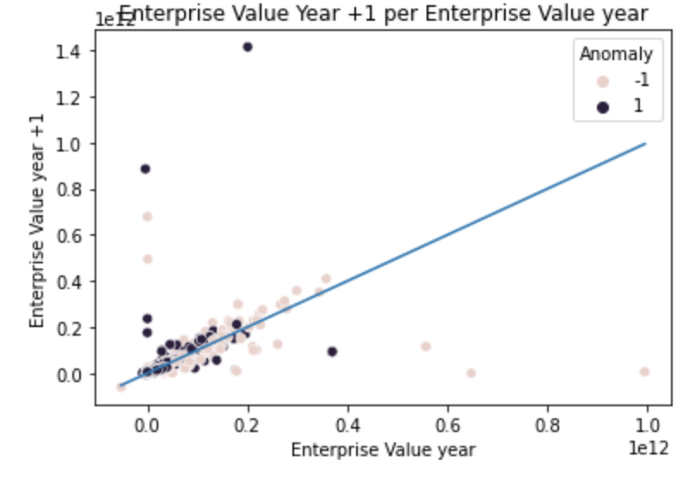
Anomaly Transactions’ key metrics behavior

Slide 17

M&A operation success rate via the PSM and Diff in Diff methods
05

Slide 18

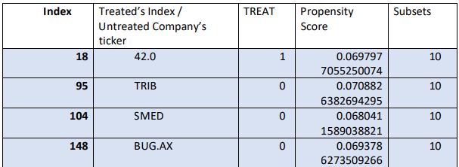
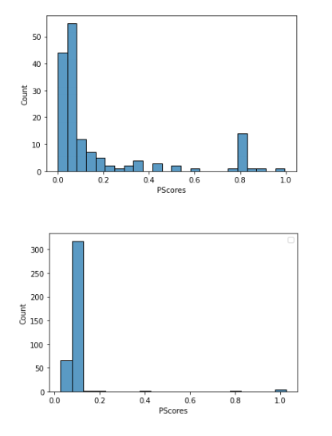
Propensity score matching ?
Propensity Scores 2000 Histograms
A table sample from our 2000 matches
It’s a branch of observational data statistical analysis
It’s goal is to reduce bias between observations of
firms who did M&A (treated) and those who didn’t (untreated).
TREAT = (0,1)
How did we use PSM ?
Opted for the ‘nearest matching algorithm’ which performs greedy nearest neighbor matching for each year panel data .
It creates a subclasses where each one contains 1 firm that did M&A and 3 others that didn't.
Propensity Scores 2009 Histograms

Slide 19
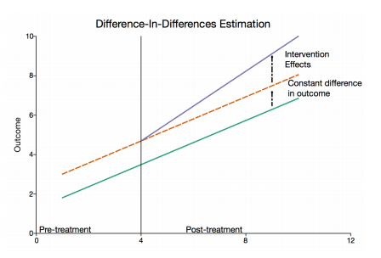
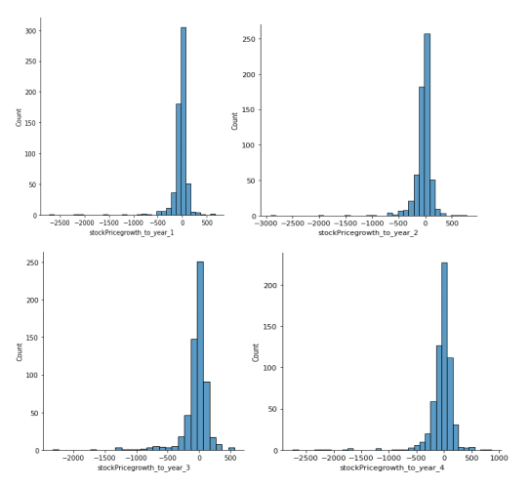
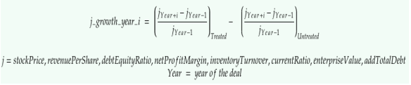
Difference in differences method ?
Results
How do we define the outcome ?

Slide 20

Findings
Limitations
Top performing firms found in our methods represent a 22% rate similarity
The general tendency of treated firms underperformance is validated throughout the whole intervention effect data frame.
The parallel tendency before the treatment is not completely verified

Slide 21

Predicting Deal Values
06

Slide 22
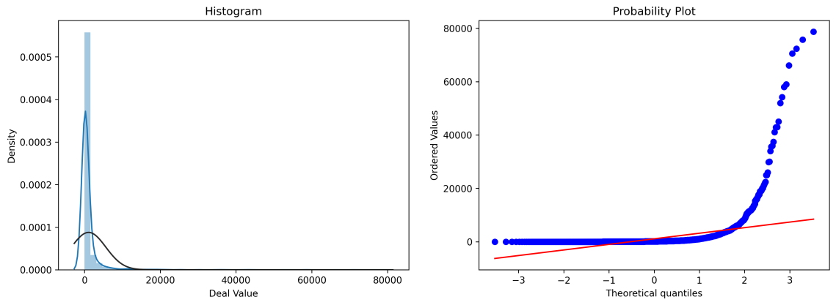
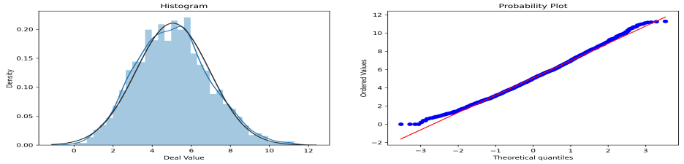
Exploratory Data Analysis
Distribution of Log (Deal Value)
Distrubution and skewness of the target feature
In order to analyze our data properly
It’s goal is to determine the relationship between our target variable and the other variables
Other Steps
Imputing Missing Values with KNN imputer
We applied log(1+x) Transformation to make the distribution normal and reduce skewness

Slide 23
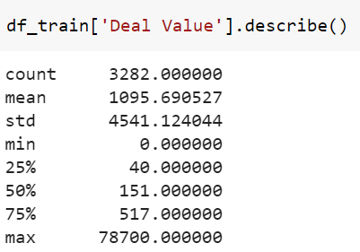
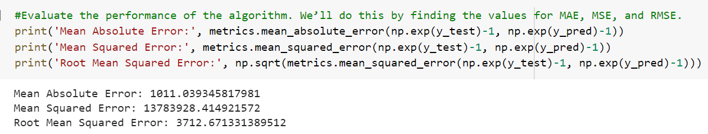
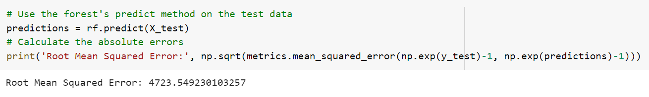
Training different models but the same result?
Hypothesis
The results obtained lead us to the hypothesis which calls into question the distribution of the variable target and the great influence of the outliers on the model, we will come back to these models in case of validation of the second hypothesis to hope for an improvement of the RMSE.

Slide 24
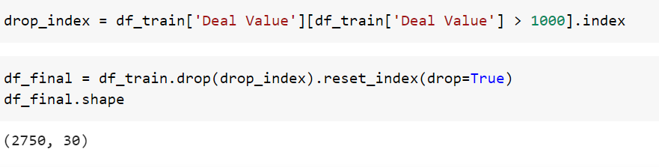
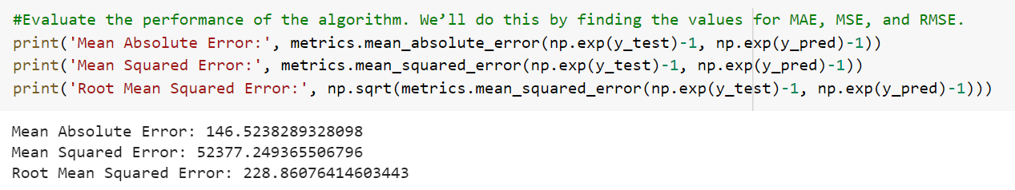
Difference after our Hypothesis?
Results
It turns out that the hypothesis was the closest to reality since we obtain an error of 22% which leads us to validate the linear regression model, we add that even after having the model of Random Forest and XGBoost, we obtained an error of 24% which remains a good result, but the most efficient is that of the linear regression.
It was proposed to keep the values between 0 and 1000 which represents 85% of all the values and which is a representative portion in case of model validation.

Slide 25

Thanks for your attention
In the end, who’s buying it ?

